Slide 1

Machine Learning in Healthcare
Ramsha,Raven, Yen,Ed Jonathan

Slide 2

Goals
Understand existing data
Statistics
Train different Machine Learning models
Analyze results and choose best model

Slide 3
Leveraged
Numpy
Seaborn
Sklearn
HTML/CSS
Heroku
Amazon AWS
Python - Google Collab
Libraries
Matplotlib
Pandas

Slide 4

Data Cleaning
Link: Google Collab
https://colab.research.google.com/drive/1zHPtiLvbVdNUXPBpKqcZGTw6uq1fd2Nv

Slide 5
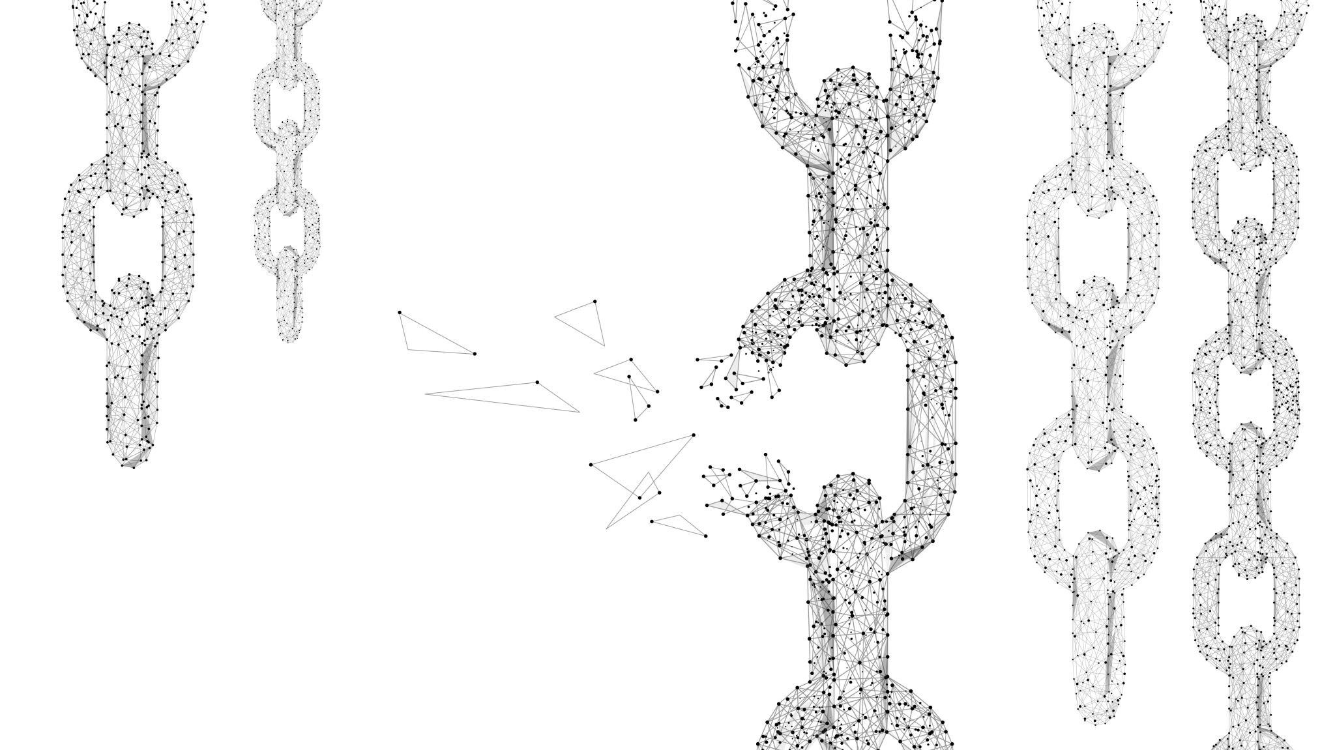
Heart Disease Prediction
https://hrt-predict-app.herokuapp.com/

Slide 6

Conclusion

Slide 7
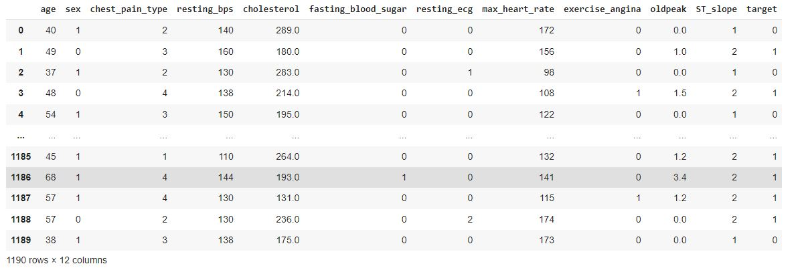
Pre-Processing

Slide 8
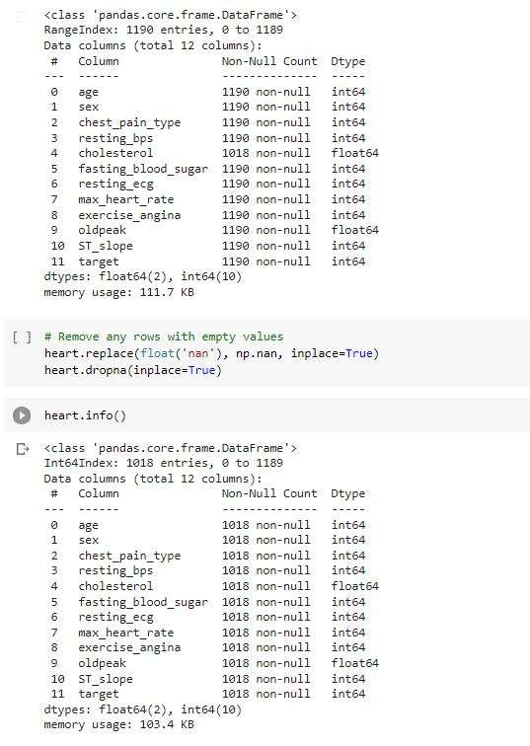
Post Processing link:

Slide 9
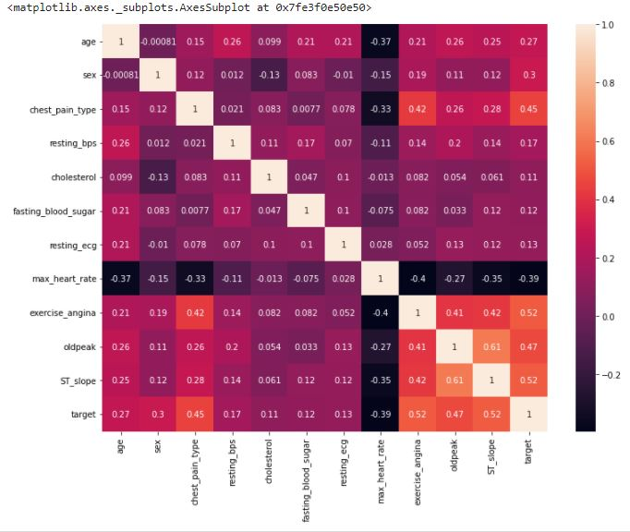
Correlation Analysis
Heat Map
Determine if individual is prone to a heart attack

Slide 10
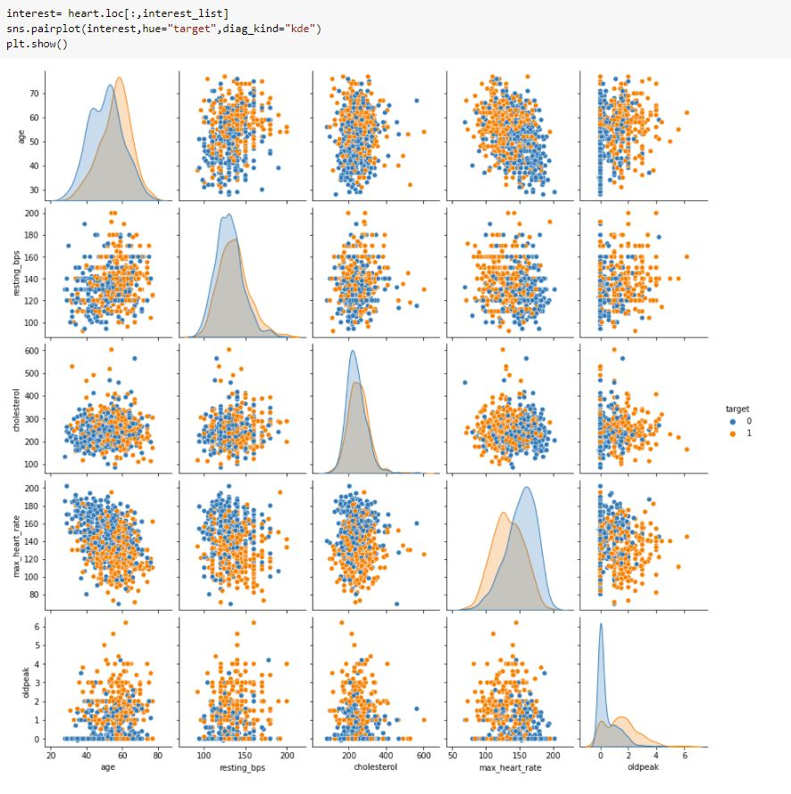
Correlation Analysis
Pair Plot
Determine if individual is prone to a heart attack

Slide 11
ML Model Comparison
Support Vector Machine - For flexibility in which it can solve both regression and classification.
Random Forest Classifier - Also flexible where it can perform both regression and classification tasks.
Category Boosting (catboost) - Handling Categorical features automatically. We can use CatBoost without any explicit pre-processing to convert categories into numbers.

Slide 12
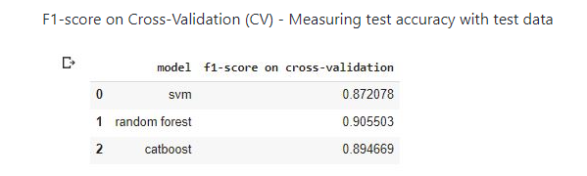
Testing Accuracy

Slide 13
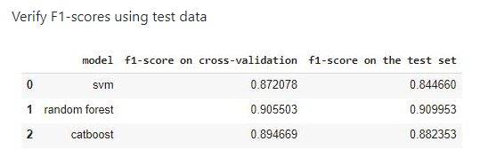
Verifying Accuracy

Slide 14
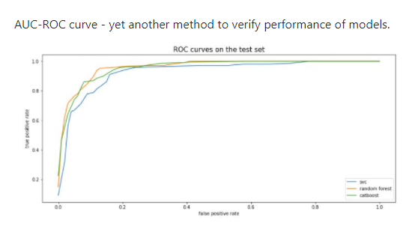
AUC-ROC Curve

Slide 15
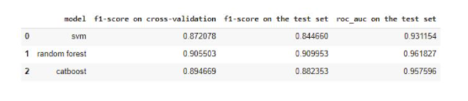
Final Results

